Slide 1




CS7.405 Responsible & Safe AI Systems
Ponnurangam Kumaraguru (“PK”)
#ProfGiri @ IIIT Hyderabad
pk.profgiri
/in/ponguru
@ponguru
Ponnurangam.kumaraguru

Slide 2
Post Conditions
C0-1: Students will recognize possible harms that can be caused by modern AI capabilities
C0-2: Students will learn to reason about various perspectives on the trajectory of AI development and proliferation
C0-3: Students will learn about latest research agendas towards making AI systems safer
C0-4: Students will be able to design and run experiments for understanding capabilities of current AI systems.
C0-5: Students will conduct, develop, and practice the techniques needed to make AI systems safer through course project

Slide 3
Pedagogy
Learning
Lectures
Reading research papers
Class participation: questions, discussions
Tutorials
Online discussion: Moodle
Learning by doing
Course project
Real world issues
Interdisciplinary approach

Slide 4
Grading, Relative
Type of Evaluation | Weightage (in %)
Quiz-II | 10
Assignments (2) | 25
Project report + Blog + Video | 10 [6 + 2 + 2]
Project | 30
Mid-term | 20
Activity / Tutorial-Follow-ups | 5

Slide 5
Project evaluation
One review every 4 weeks
Total of 4 reviews
5 + 5 + 5 + 15 marks
External evaluators for the projects (preferably mid & final)
If things work out well, you can continue working on the project through the summer / fall semester

Slide 6
Moodle
We will use Moodle for all content sharing – slides, HWs, announcements, clarifications, etc.

Slide 7
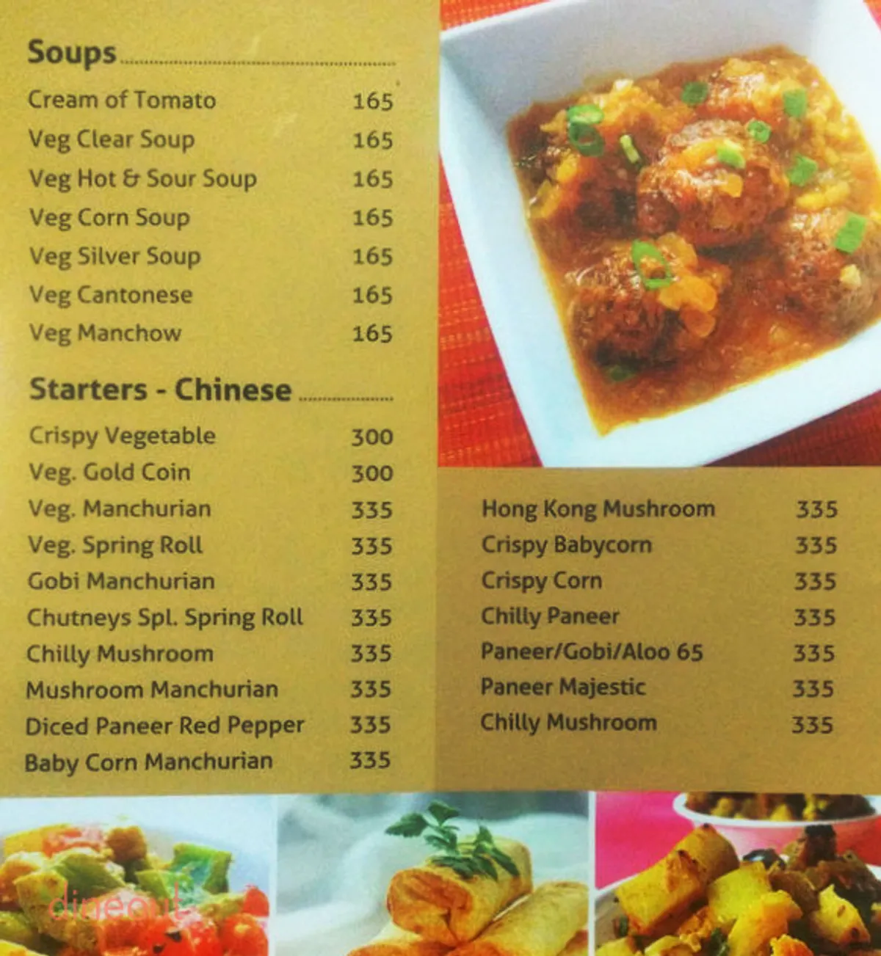
Topics that we will cover
Introduction to AI Capabilities and Risks
Adversarial Robustness
Transparency
Artificial General Intelligence
AI Governance and Career Opportunities
https://www.dineout.co.in/hyderabad/chutneys-madhapur-west-hyderabad-11747/menu

Slide 8
Who you are?
You name
Your program
Why taking this course in a couple of lines
Lets discuss a few of these after you are done
What do you want to get out of the class?
Write in the paper, with your name and Roll #

Slide 9
This Lecture

Slide 10
Improvement in AI capabilities: Your list? Your life time?

Slide 11
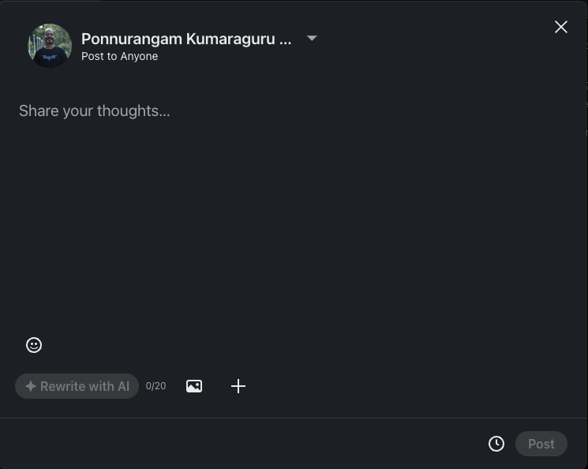
Improvement in AI capabilities

Slide 12
Improvement in AI capabilities: Your list?
Transportation
Healthcare
Banking
Entertainment
E-Commerce
Education

Slide 13
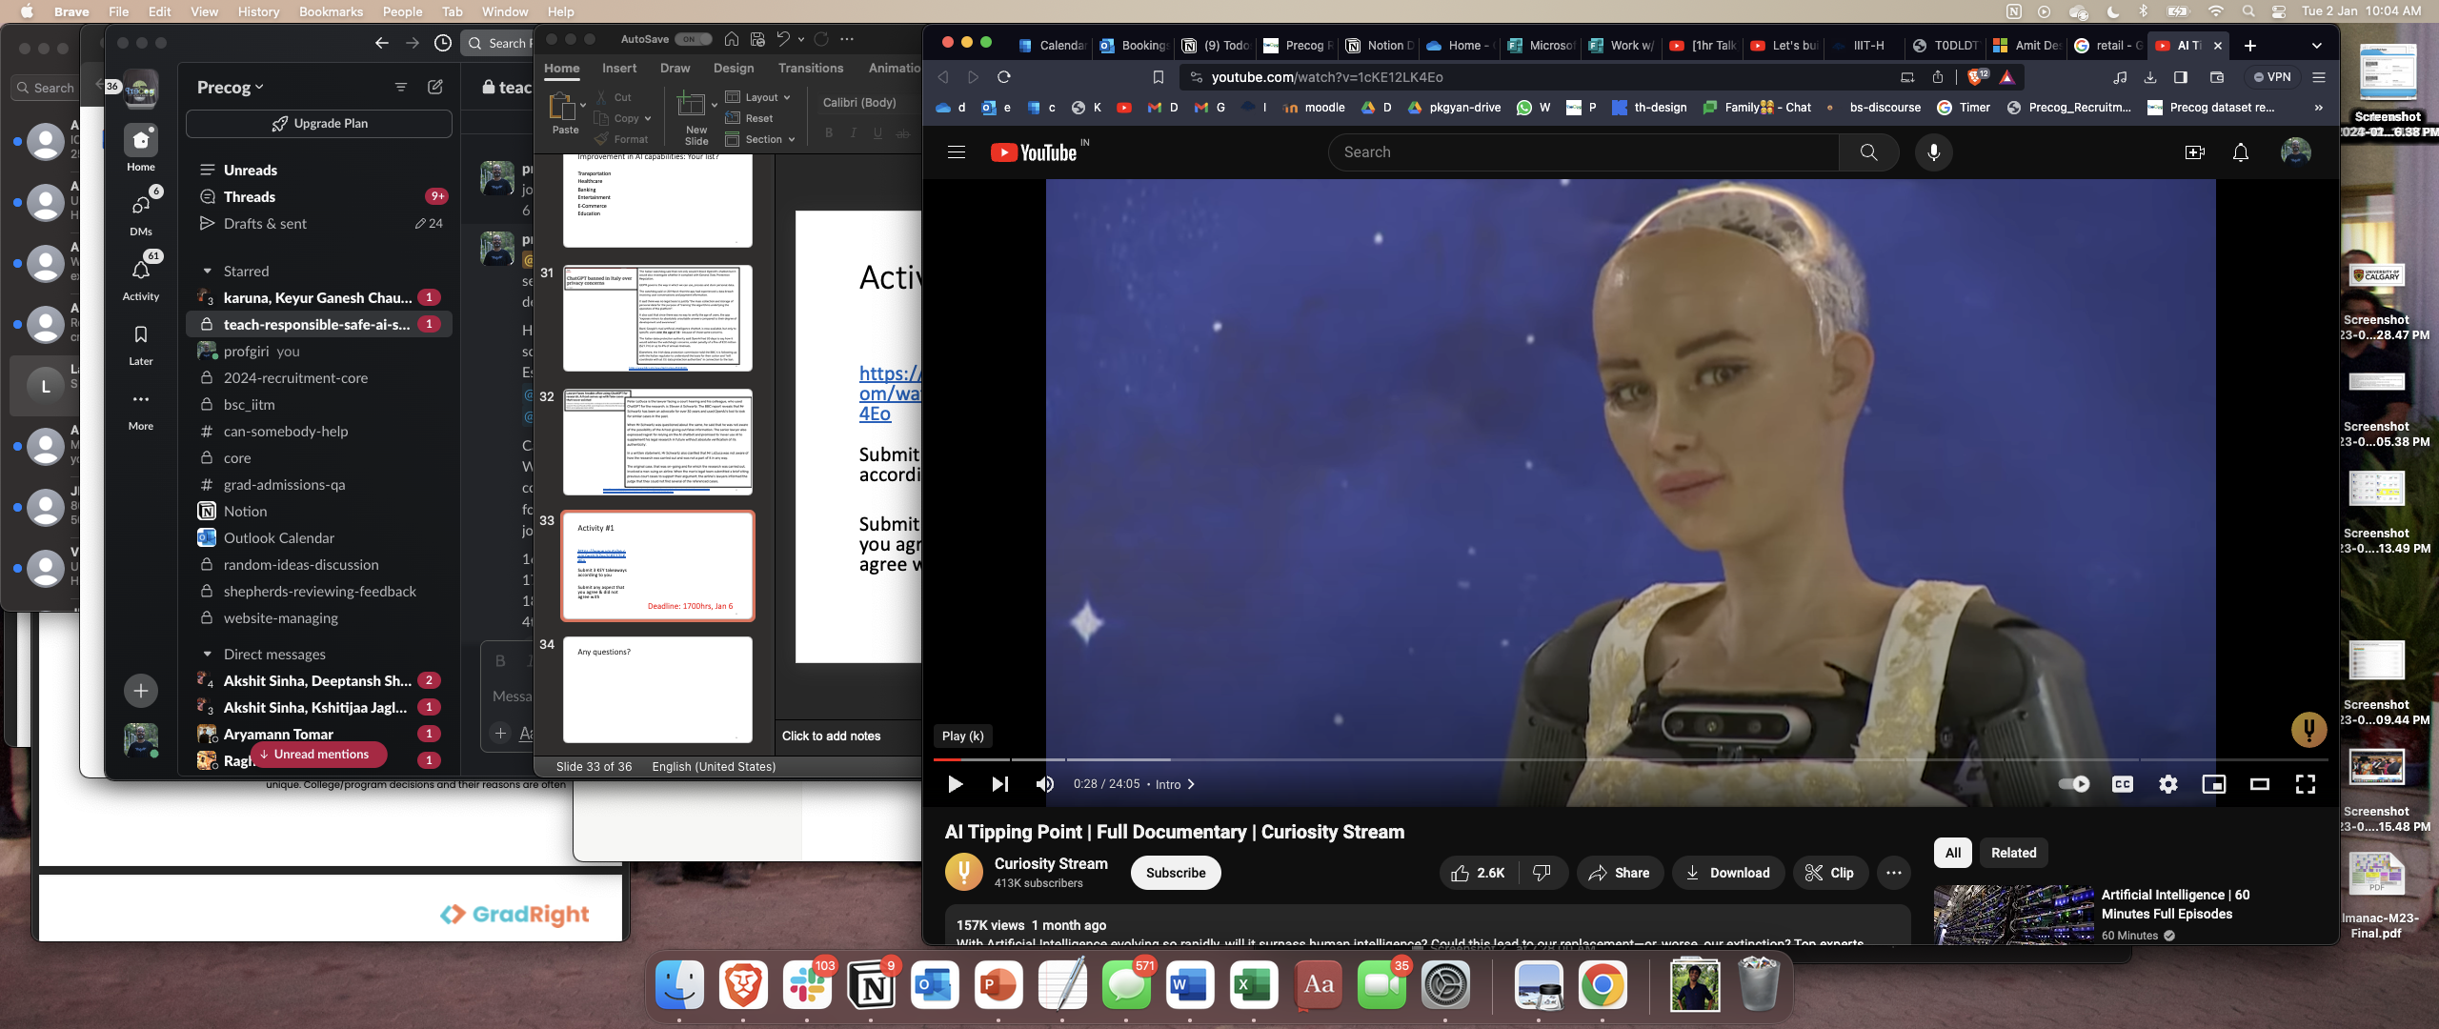
Activity #1
Your submissions? 3 KEY takeaways
(didn’t) agree
Deadline: 23:59hrs, Jan 6

Slide 14
Your responses
Why taking this course in a couple of lines
What do you want to get out of the class?

Slide 15
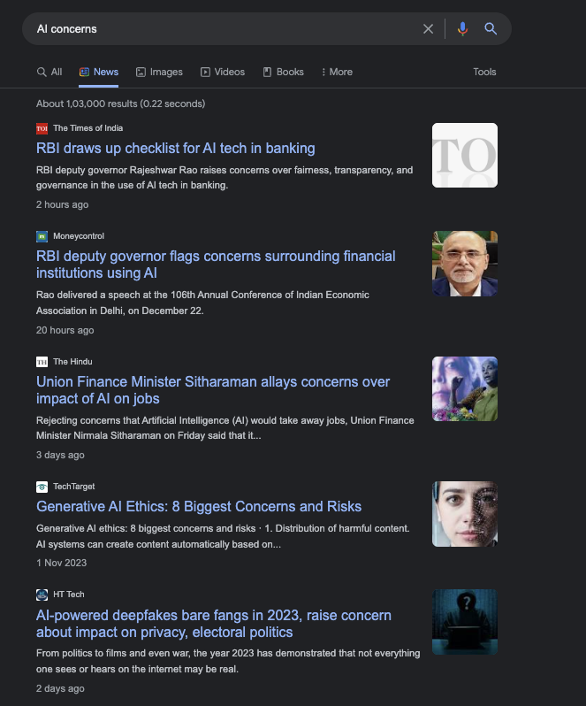

Slide 16
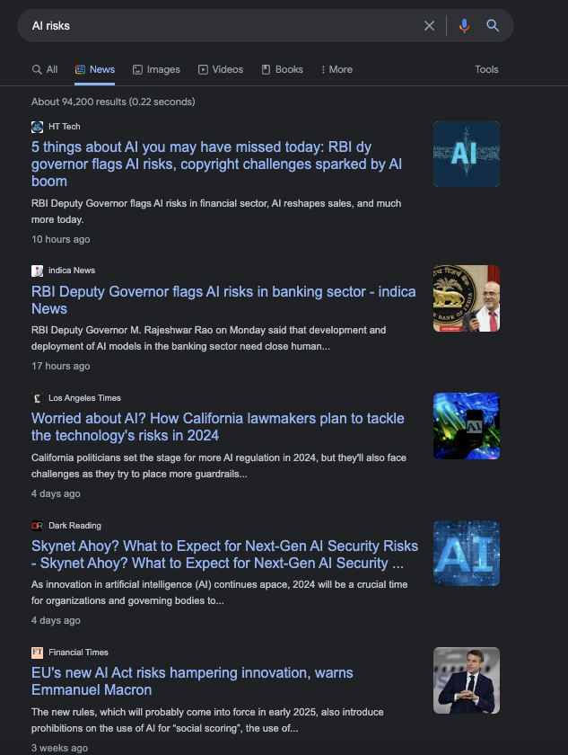

Slide 17
What is the current situation?
Hard to differentiate between AI & Human
How did we get here?
Scaling up algorithms
Scaling up data for training
Increasing computing capabilities
Not many predicted that we would have these advancements
Worry about AI overtaking Human

Slide 18
Any questions?

Slide 19
Bibliography / Acknowledgements
https://medium.com/@richardcngo/visualizing-the-deep-learning-revolution-722098eb9c5

Slide 20





pk.profgiri
Ponnurangam.kumaraguru
/in/ponguru
ponguru
Thank you
for attending the class!!!
pk.guru@iiit.ac.in

